Slide 1

Supermarket Sales Inside Report:
Unveiling Performance of Quarter 1
January’2019 – March’2019

Slide 2

Overview of Quarter 1 Sales Report and Insights
Achievements
Exceptional Sales Achievement at Naypyitaw Branch
January have the heist sales
Increasing Utilization of Cash and E-Wallets Over Credit Cards
Quarter 1 company achieve overall 7 Rating
Insights Analysis
Store Performance Analysis Report
Annual Revenue Run Rate Report

Slide 3

Overall Achievements for the Quarter 1 of 2019
For the period spanning January through March, three branches of our brand are currently operational, and the achieved performance metrics are outlined below.
₹3,22,967
₹15,379
Over the course of the past three months, our three branches have successfully sale over ₹3L of items.
Over the past three months, our company has recorded a total gross income exceeding ₹15,300.
55,110
7 Star Rating
Products from six distinct product lines were sold during the past three months.
Average rating of our 3 branches combined is 7 star.
Cash
Increasing Utilization of Cash and E-Wallets Over Credit Cards

Slide 4

Individual Branch Achievements[Q1]
Naypyitaw
Yangon
Mandalay
₹1,10,569 sales it is the heist among 3 branches.
The branch has generated a gross income of ₹5,265.
7.1 Stare rating achieved this branch.
₹1,06,200 sales it is the 2nd heist among 3 branches.
The branch has generated a gross income of ₹5,057.
7 Stare rating achieved this branch.
₹1,06,198 sales it is the lowest among 3 branches.
The branch has generated a gross income of ₹5,057.
6.8 Stare rating achieved this branch.
The Mandalay branch has attained a rating of 6.8 stars, representing the lowest rating among our three branches. Our analysis reveals that this branch has recorded comparatively lower sales than its counterparts. We recommend a thorough examination of factors contributing to this performance gap to devise strategies for improvement.

Slide 5
Product Line Sales Trend Overview
The heatmap below will assist us in identifying the trends in customer spending over the last three months.
 | Health and beauty | Electronic accessories | Home and lifestyle | Sports and travel | Food and beverages | Fashion accessories
January | 16383 | 18831 | 20495 | 21667 | 19571 | 19345
February | 14602 | 17363 | 12434 | 13810 | 20000 | 19010
March | 18208 | 18143 | 20933 | 19646 | 16574 | 15951
In February, we observed a decline in sales for Home and Lifestyle as well as Sports and Travel categories, resulting in a negative 0.84X drop in revenue compared to the previous month's sales.

Slide 6
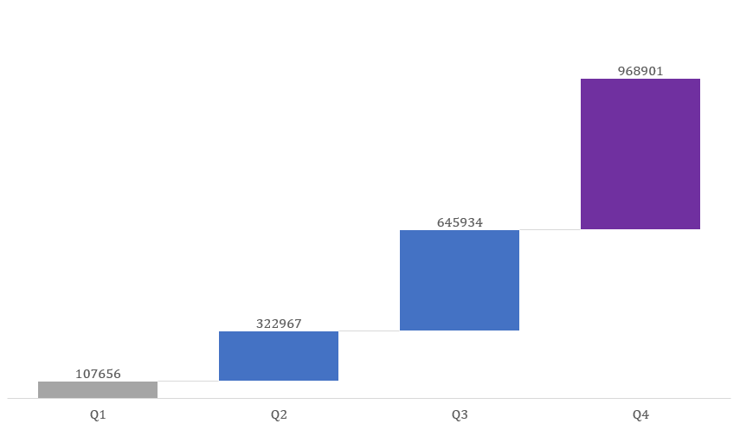
Annual Revenue Run Rate Report
Utilizing the average sales figures from the past three months to forecast forthcoming sales numbers.
Utilizing ARR metrics, we employed a robust methodology to forecast our forthcoming sales. The results indicate a projected total exceeding ₹9,68,900 by year-end. This analytical approach, based on Annual Recurring Revenue, enhances our ability to make informed strategic decisions and align our business objectives with financial projections. The precision of our predictions underscores our commitment to data-driven decision-making, providing a solid foundation for anticipating and navigating future financial outcomes.
Predicted Sales Figures For the Year 2019

Slide 7




Thank you
Contact Me
Sayan Karmakar
Data Visualization Analyst
sayanjoy17@gmail.com
https://github.com/Sayanjoy2

